Slide 1
PHD K A N PRANAVHARSHA

Slide 2
TIME SERIES FORECASTING

Slide 3
Problem Description
The problem statement is to forecast the sales for the next 12 months on three different clothing categories
The data contains sales information by month from 2009 – 2015. We need to forecast for the year 2016 based on month.
Data contains the following attributes :
Year
Month
Product Category
Sales in Thousand Dollars

Slide 4
Data Pre Processing
Separated the data into Women Clothing, Men Clothing, Other Clothing sets.
Checked for the null values.
Imputed the null values with central imputation.
Removed the Product Category from the data.
Created Time Series Objects.

Slide 5
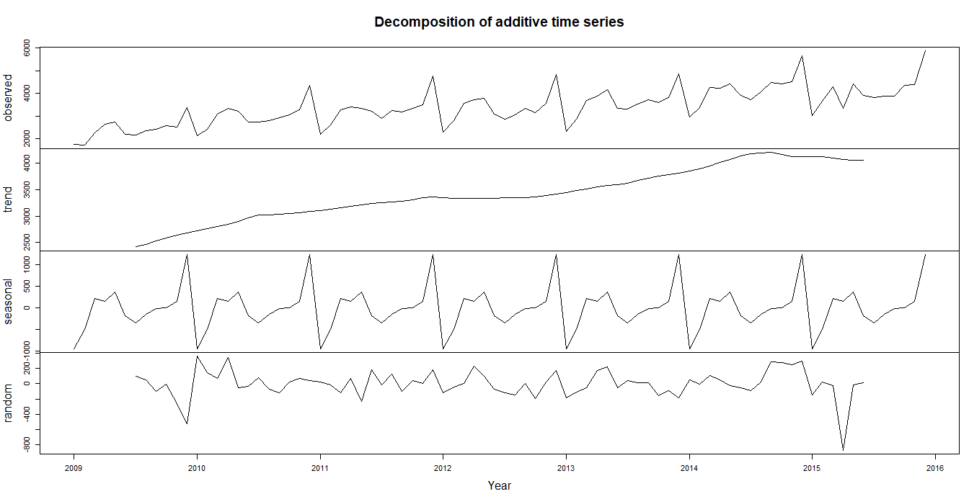
Women Clothing Time Series

Slide 6
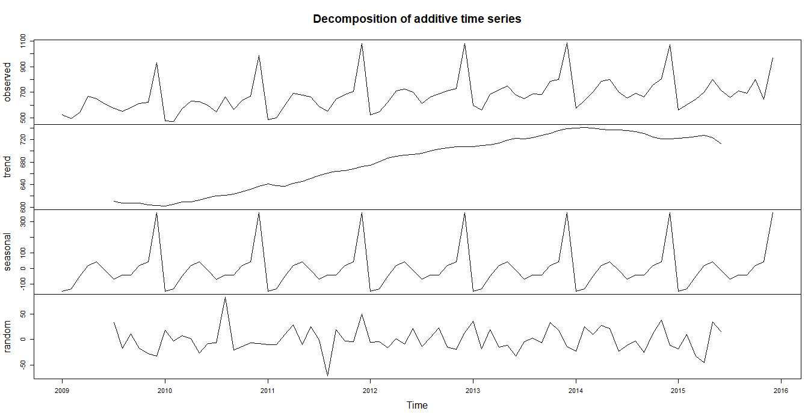
Men Clothing Time Series

Slide 7
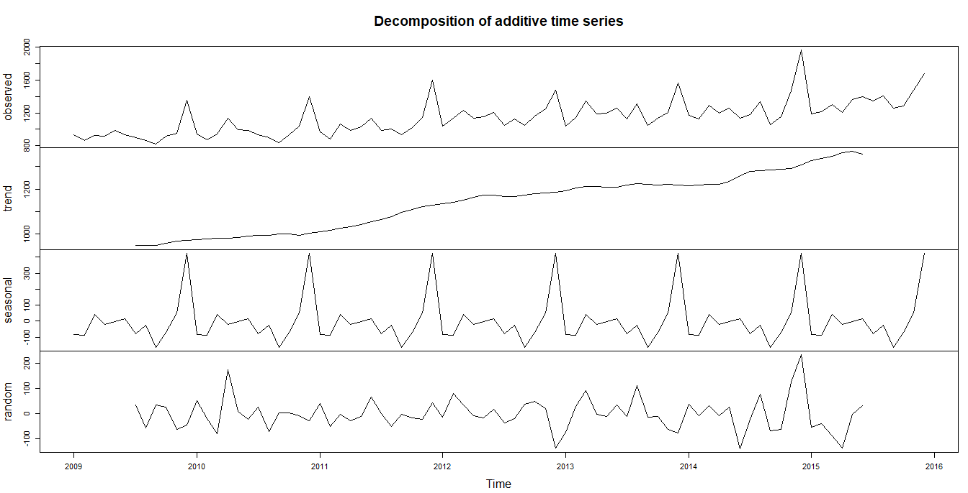
Other Clothing Time Series

Slide 8
Modelling
Tried various models and their MAPE is as below:
The best model is ARIMA with following p, d, q and P, D, Q values
Women Clothing: (0, 1, 1) (2, 2, 2)
Men Clothing: (0,1,1) (0,1,1)
Other Clothing: (0,0,0) (1,2,2)
Model Name | Women Clothing (Train MAPE) | Men Clothing (Train MAPE) | Other Clothing (Train MAPE) | Overall Test MAPE
SMA | 8.06 | 8.08 | 6.27 | 26.06
Holt Winters | 15.06 | 16.15 | 14.27 | 18.09
Auto ARIMA | 4.80 | 3.53 | 4.24 | 10.329
Best Tuned ARIMA | 4.15 | 3.51 | 3.21 | 9.39

Slide 9
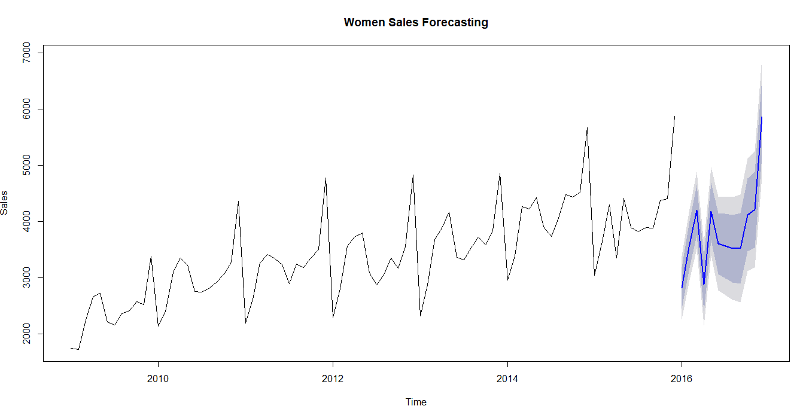
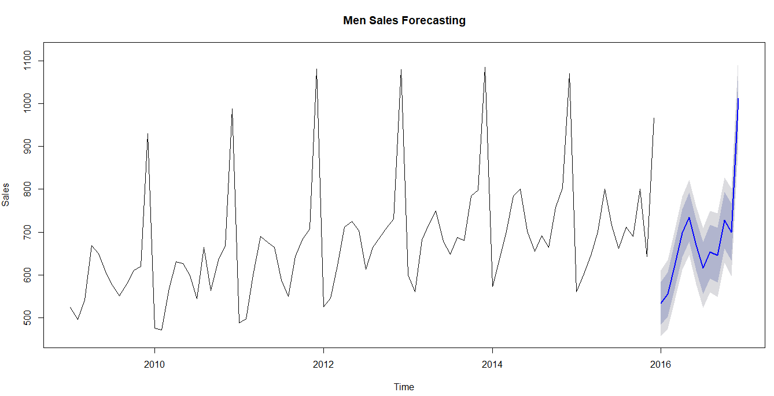
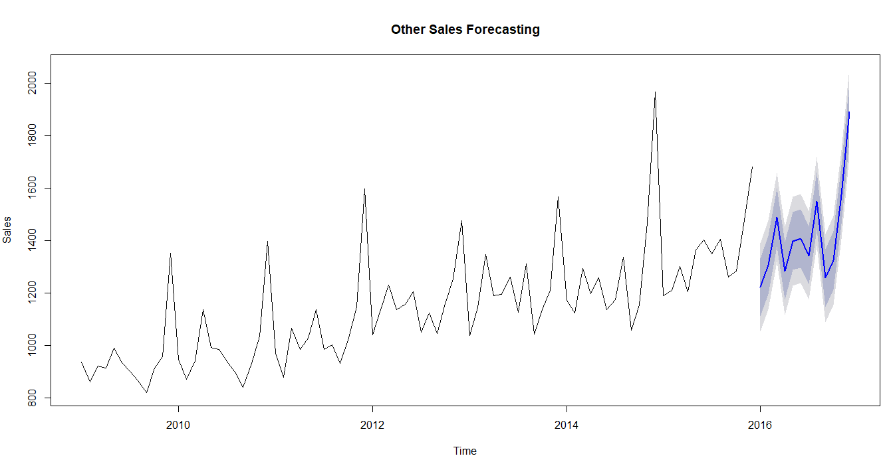

Slide 10
Regression Analysis

Slide 11
Problem Description
The problem statement is to forecast the sales for the next 12 months on Women Clothing category using various other factors from weather, economic and holidays.
The data contains sales information by month from 2009 – 2015. We need to forecast for the year 2016 based on month.
The Weather Data, Economic Data, Holidays Data contains information from 2009 – 2016.

Slide 12
Data Pre Processing (Sales Data)
As the data contains all the categories, filtered out Women Clothing category alone.
Checked for the null values.
Imputed the null values with central imputation.
Removed the Product Category from the data.

Slide 13
Data Pre Processing (Weather Data)
Read all the data in excel sheets into separate data-frames because each sheet has its own type of missing values and in all the sheets the year is mentioned as 2009.
Changed the year from 2009 to respective years.
Changed “-” and “?” values in some of the attributes to null values.
Changed the “T” value in Precipitation attribute to zero because T means “Trace” which says that there is very small amount of rain or snow and cannot be measured. So, made the value zero.
Removed the attribute Weather Event because almost 70% of the values are null and another reason is the same thing is explained by the precipitation. So, removed the attribute. Dropped Day from the dataset as it has no significance.
Aggregated the data by month for each and every year.
Combined all the year attributes of all years from period 2009-2015 and created train dataset, 2016 with test dataset.

Slide 14
Data Pre Processing (Holidays Data)
Checked for null values. There were no null values.
MonthDate attribute was given with correct month and wrong year. Year was given as a separate attribute.
Aggerated the data by month and year and created new feature count which holds the number of holidays in that particular year and month irrespective of Holiday category.
Dropped the attributes Event and Holiday category as it is aggregated to month.
In some of the months there were no holidays. So, took count as zero.

Slide 15
Data Pre Processing (Economic Data)
Separated the Year, Month from the year-month attribute.
Already the data was aggregated by month.
Dropped the Party in Power attribute because all the values have same.
Dropped Advertising expenses as 73 values were null.

Slide 16
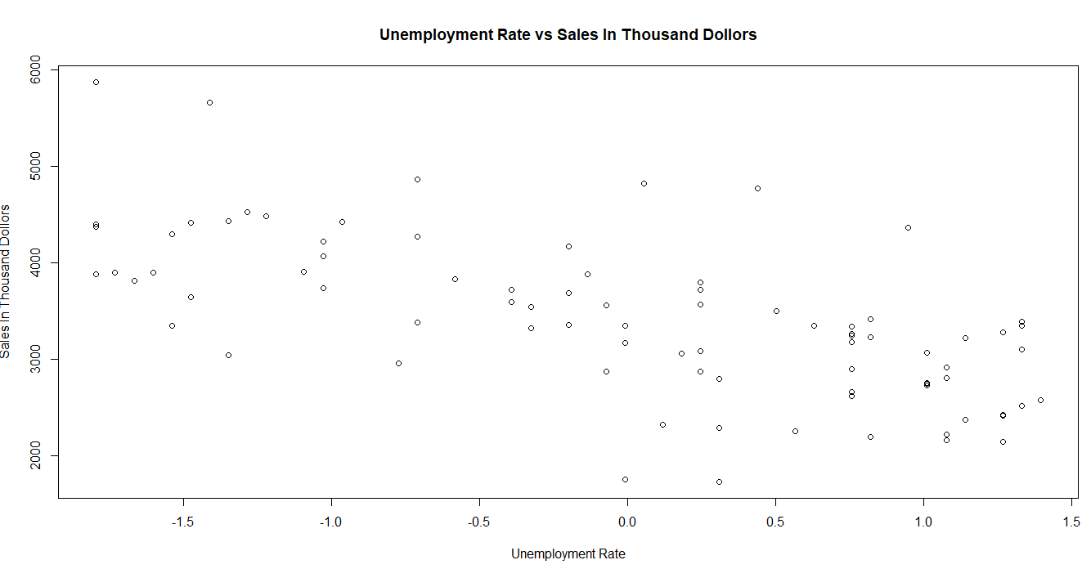
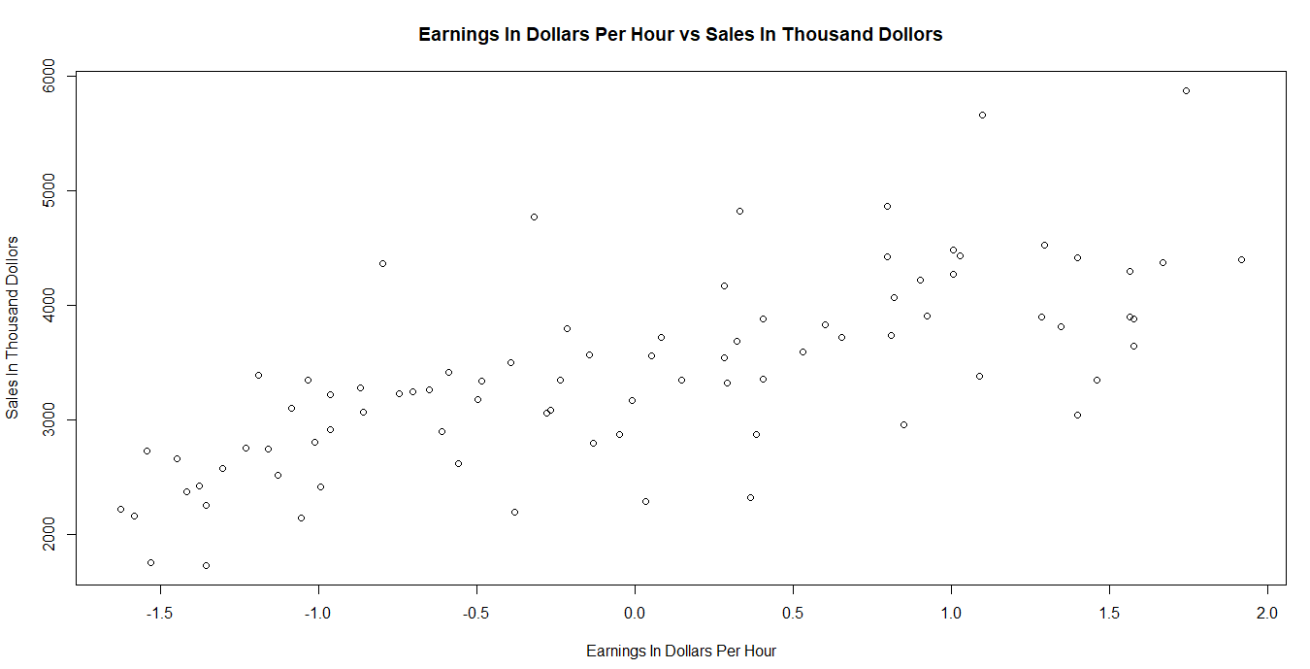
Insights

Slide 17
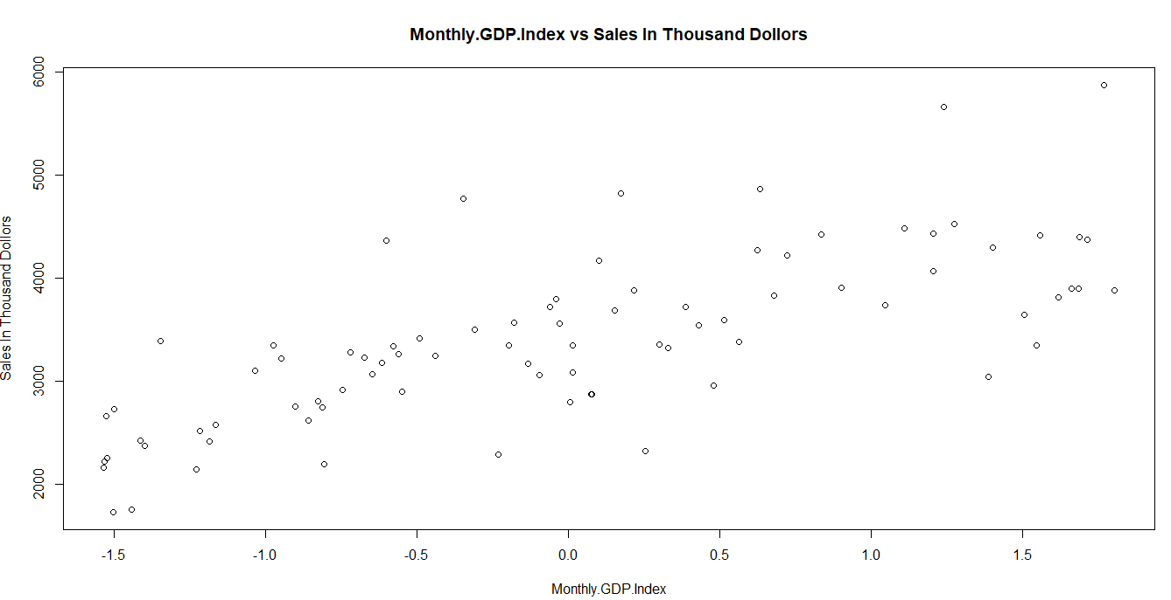
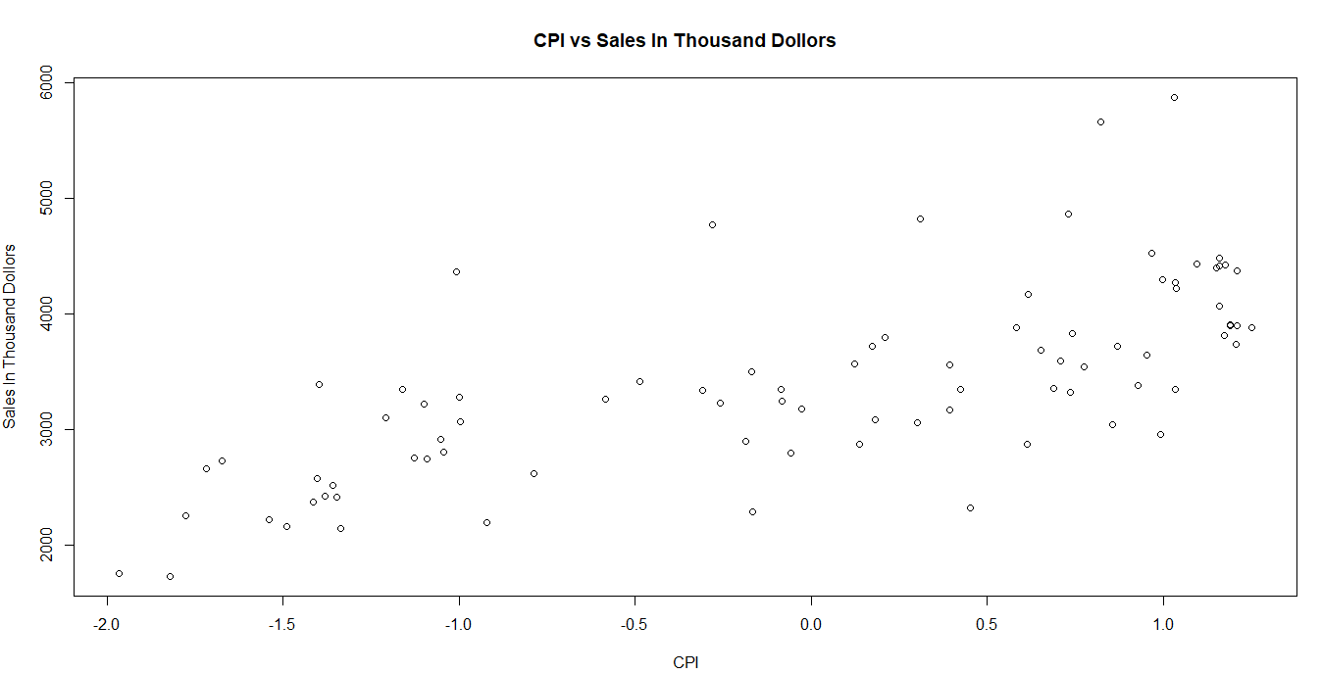
Insights

Slide 18
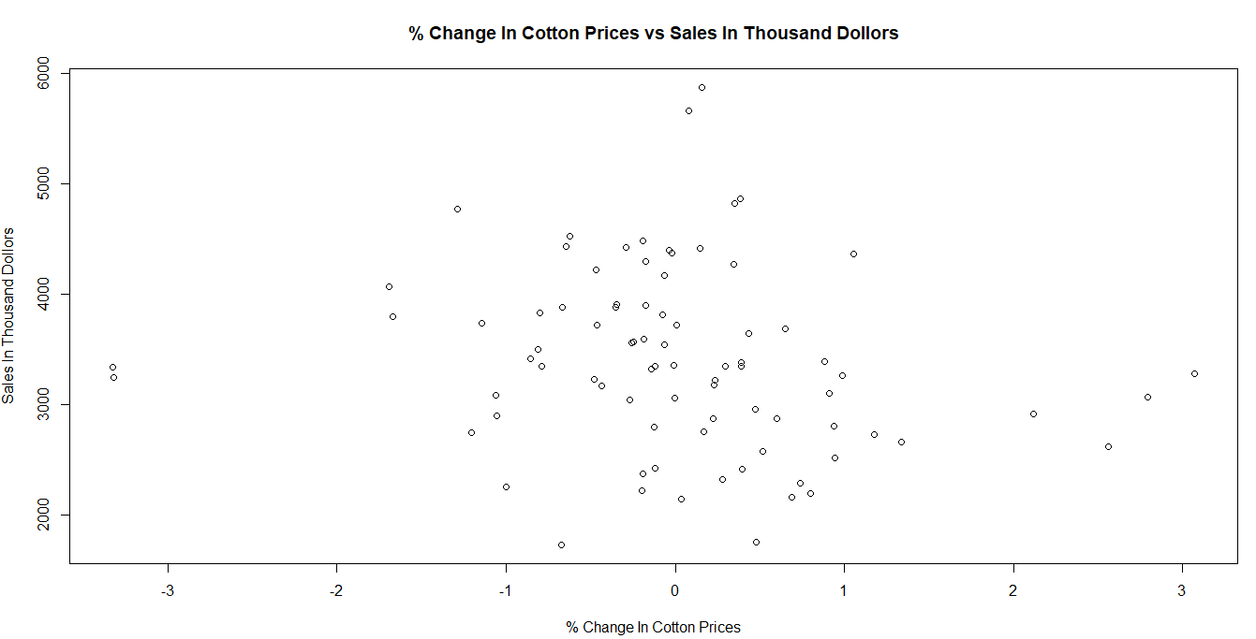
Insights

Slide 19
Modelling
Parameters for the best model:
GBM - Interaction depth=2, shrinkage=0.01, n-trees=1800
Model | Train MAPE | Test MAPE
Linear Regression | 7.97 | 50.87
Linear Regression with Log | 6.56 | 46.40
Linear Regression with Log after Step AIC | 3.53 | 17.93
Lasso Regression | 3.66 | 13.36
Ridge Regression | 6.24 | 16.75
Random Forests | 4.05 | 12.80
GBM | 2.692 | 9.588
Tuned GBM | 1.02 | 7.25

Slide 20
Improvements
Can try some more feature engineering.
Can tune Random forests to reduce the error.

Slide 21
Conclusion
Regression analysis is giving better prediction in sales than Time series predictions because here we are considering other factors from weather, economic factors and holidays data.

Slide 22
THANK YOU

